Slide 1
03
MACHINE LEARNING WITH SCIKIT-LEARN
Feature Engineering
& Pipelines
Turn clean columns into model-ready numbers — and chain everything into leak-proof scikit-learn Pipelines.
Instructor: Shutchon Premchaisawatt
Master's Degree Program · Hands-on with Google Colab

Slide 2
AGENDA
Today's agenda
01
Why models need numbers & scales
the fare-vs-age problem
05
Pipeline
chain preprocessing + model
02
Scaling
Standard · MinMax · Robust
06
ColumnTransformer
different steps per column type
03
Encoding categories
OneHot vs Ordinal
07
Data leakage
the silent score killer
04
Feature engineering recipes
bin, log, combine — then MEASURE
Machine Learning with scikit-learn
SESSION 03 · 3

Slide 3
FROM LAST SESSION
Clean data is not model food (yet)
raw data
S02 arrival
→
clean data
no missing, no dupes
→
transformed
numbers, sane scales — TODAY
→
model-ready
inside one Pipeline
Still text
sex = "female"
embarked = "S"
Models: TypeError.
Wildly different scales
age 0–80 vs fare 0–512
Distance-based models quietly break.
Manual transforms
Applying them by hand, twice (train/test),
invites leakage. Enter Pipelines.
Machine Learning with scikit-learn
SESSION 03 · 4

Slide 4
WHY SCALING
KNN is blind when one column shouts
0.67
0.82
Why: KNN measures distance
Δfare can be 500 · Δage at most 80
fare drowns every other signal
Same story for SVM, K-Means, PCA
+15 points for free — just rescaling
KNN accuracy
fare & age unscaled
same KNN, same data
after StandardScaler
Trees (DecisionTree, RandomForest) split one feature at a time — scaling changes nothing for them.
Machine Learning with scikit-learn
SESSION 03 · 5

Slide 5
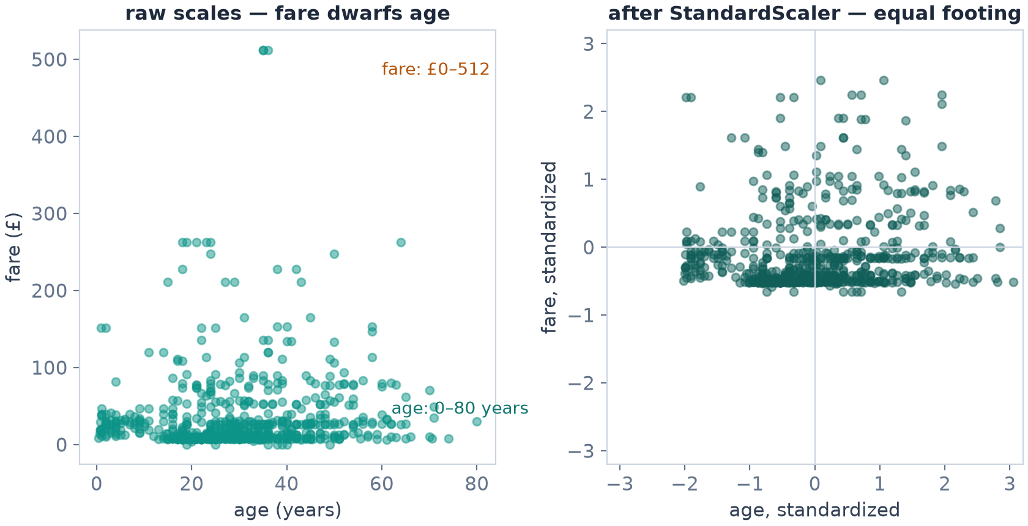
WHY SCALING
Scaling, visually — before & after
Left: raw Titanic age × fare
fare's 0–512 range crushes the picture
Right: after StandardScaler
both features: mean 0, spread ±2 — equal footing
Same data, same KNN: 0.67 → 0.82
Machine Learning with scikit-learn
SESSION 03 · 6

Slide 6
SCALING
Three scalers you'll actually use
scaler | formula (idea) | use when
StandardScaler | center to mean 0, std 1 | default first choice
MinMaxScaler | squash to [0, 1] | need a bounded range (NN, images)
RobustScaler | center by MEDIAN, scale by IQR | heavy outliers (fare!)
fit_transform on TRAIN
transform on TEST
never fit on the test set!
  (we'll automate this discipline with Pipelines in a few slides)
from sklearn.preprocessing import StandardScaler
scaler = StandardScaler()
X_train_s = scaler.fit_transform(X_train[num]) # learns train stats
X_test_s = scaler.transform(X_test[num]) # reuses them
Machine Learning with scikit-learn
SESSION 03 · 7

Slide 7
SCALING
Who needs scaling? A field guide
Scale-sensitive
KNN — pure distance
SVM (RBF) — distance in kernel space
PCA — variance-based
Linear/Ridge/Lasso — coefficient penalties assume comparable scales
Neural nets — optimizers behave badly on wild scales
→ always scale these
Scale-indifferent
DecisionTree — thresholds per feature
RandomForest — many trees
GradientBoosting — trees inside
→ scaling optional (harmless, but no gain)
Practical rule: put scaling in the Pipeline anyway. It costs nothing and protects the model you swap in later.
Machine Learning with scikit-learn
SESSION 03 · 8

Slide 8
ENCODING
Categories → numbers: two doors
ONE-HOT — one column per category
Which door?
order exists → OrdinalEncoder
no order → OneHotEncoder
sex, embarked → one-hot
pclass → already ordered ints
Danger: encoding "female"=1 "male"=0 with a LINEAR model is fine, but "city": Bangkok=1, ChiangMai=2, Phuket=3 invents a fake order
embarked
→
S
C
Q
no fake order invented · grows wide with many categories
ORDINAL — one column, ordered ints
size
→
small 0
med 1
large 2
only when an order truly exists (size, rating, education)
Machine Learning with scikit-learn
SESSION 03 · 9

Slide 9
ENCODING
OneHotEncoder in action
from sklearn.preprocessing import OneHotEncoder
oh = OneHotEncoder(handle_unknown="ignore")
oh.fit_transform(X_train[["sex", "embarked"]]).toarray()
handle_unknown="ignore"
at deploy time a NEW category appears → all-zeros row, no crash
Sparse output
fit_transform returns a sparse matrix (mostly zeros) — memory-friendly
  1000 categories? 1000 columns. High cardinality needs other tricks (group rare, hashing) — beyond today.
sex_F | sex_M | emb_S | emb_C | emb_Q | …
1 | 0 | 1 | 0 | 0
0 | 1 | 0 | 1 | 0
Machine Learning with scikit-learn
SESSION 03 · 10

Slide 10
FEATURE ENGINEERING
Recipes that earn their keep
Bin
age → is_child (age<12)
continuous → flag or band
("women and children first")
Log-transform
fare_log = log1p(fare)
tames skew 4.8 → ~0.5
helps linear & distance models
Combine
family_size = sibsp + parch + 1
lonely traveler vs big family —
its own survival pattern
Ratio
fare_per_person = fare / family_size
prices normalized by group size
(fees, spend per tenure…)
X = df.drop(columns="survived")
X["family_size"] = X["sibsp"] + X["parch"] + 1
X["is_child"] = (X["age"] < 12).astype(float)
X["fare_log"] = np.log1p(X["fare"])
Then MEASURE
KNN 5-fold CV: 0.809 → 0.819 ✓ small win
RandomForest: 0.807 → 0.801 ✗ no gain
Features must EARN their place — keep only what measurably helps
Machine Learning with scikit-learn
SESSION 03 · 11

Slide 11
THE PROBLEM
Doing it by hand — the bookkeeping trap
# manual way: 9 fiddly steps, every single time
imp_num = SimpleImputer(...).fit(X_train[num])
Xtr_num = imp_num.transform(X_train[num])
Xte_num = imp_num.transform(X_test[num])
scaler = StandardScaler().fit(Xtr_num)
Xtr_num = scaler.transform(Xtr_num)
Xte_num = scaler.transform(Xte_num)
oh = OneHotEncoder(...).fit(X_train[cat])
Xtr_cat = oh.transform(X_train[cat]).toarray()
Xte_cat = oh.transform(X_test[cat]).toarray()
X_train2 = np.hstack([Xtr_num, Xtr_cat]) # never again
Three failure modes:
① forget a transform on test → crash or garbage
② accidentally fit on test → leakage
③ new data at deploy → re-do the whole dance
sklearn's answer: Pipeline + ColumnTransformer — next
Machine Learning with scikit-learn
SESSION 03 · 12

Slide 12
★ THE BIG IDEA
Pipeline: one object, all steps
raw columns
mixed types, missing
→
imputer
fill missing
→
scaler / encoder
make numbers sane
→
model
fit + predict
from sklearn.pipeline import Pipeline
pipe = Pipeline([("imp", SimpleImputer()),
("sc", StandardScaler())])
pipe.fit(X_train, y_train)
runs imp.fit_transform → sc.fit_transform in order
pipe.transform(X_test)
runs imp.transform → sc.transform (learned stats reused)
With a model inside: fit / predict / score — one call each
Machine Learning with scikit-learn
SESSION 03 · 13

Slide 13
★ THE BIG IDEA
ColumnTransformer: different food per column
numeric
columns
median impute
+ StandardScaler
→
→
  Columns not listed? By default they pass through untouched (or set remainder="drop")
This one object replaces ALL the manual bookkeeping
concat →
model-ready matrix
categorical
columns
mode impute
+ OneHotEncoder
→
→
pre = ColumnTransformer([
("num", num_pipe, ["age","fare","sibsp","parch","pclass"]),
("cat", cat_pipe, ["sex","embarked"])])
Machine Learning with scikit-learn
SESSION 03 · 14

Slide 14
★ THE TEMPLATE
The 15-line template you'll reuse forever
num_pipe = Pipeline([("imp", SimpleImputer(strategy="median")),
("sc", StandardScaler())])
cat_pipe = Pipeline([("imp", SimpleImputer(strategy="most_frequent")),
("oh", OneHotEncoder(handle_unknown="ignore"))])
pre = ColumnTransformer([("num", num_pipe, num_cols),
("cat", cat_pipe, cat_cols)])
clf = Pipeline([("pre", pre),
("model", KNeighborsClassifier())])
clf.fit(X_train, y_train)
clf.score(X_test, y_test) # 0.816 — everything inside
Swap the model
KNeighborsClassifier() →
LogisticRegression() →
RandomForestClassifier()
…the 15 lines don't change
  Save clf with joblib → load in production → feed raw rows. Same result.
Machine Learning with scikit-learn
SESSION 03 · 15

Slide 15
GUARANTEE
Inside clf.fit(): train-only discipline for free
clf.fit(X_train, y_train)
the only fit() you call
→
pre fits on TRAIN only
median, std, categories
→
model learns
on transformed train
clf.predict(X_new)
raw new data
→
pre.transform()
reuses TRAIN stats
→
model.predict()
done
Why this matters
Every statistic (imputation values, scaling mean/std, one-hot columns) is learned from TRAINING data only, then merely applied to test/future data. That discipline is exactly what the manual way keeps getting wrong.
Machine Learning with scikit-learn
SESSION 03 · 16

Slide 16
DATA LEAKAGE
When information from OUTSIDE the training set
— usually from the future or from the target itself —
sneaks into your model.
The score looks amazing. The deployed model is useless.
It is the #1 silent killer of real-world ML projects — and AI assistants generate it happily.
Machine Learning with scikit-learn
SESSION 03 · 17

Slide 17
LEAKAGE
Watch a leak happen — "lucky_ticket"
We invent a column that secretly knows the answer (85% of the time) — like using next month's refund record to predict this month's churn.
0.804
0.860
In real projects the leak is rarely this obvious
"days_since_last_complaint" for churn — filed AFTER cancelling?
"total_billed" including the refund after churn
Ask of every column: WHEN was this value known?
LogisticRegression
honest features
same model + lucky_ticket
+5.6 pts of pure illusion
Machine Learning with scikit-learn
SESSION 03 · 18

Slide 18
LEAKAGE
The five usual suspects
suspect | how it leaks | defense
Scaler / imputer fit on ALL rows | test statistics bleed into training | Pipeline (fit inside)
Target-derived feature | lucky_ticket, post-outcome fields | ask WHEN the value existed
Duplicates across the split | model examined the exam in advance | drop_duplicates first
Group-aware splits | same patient/user in train AND test | GroupSplit (advanced)
Tuning on the test set | repeated peeking = soft memorization | CV for tuning, test ONCE (S04)
Defense in one line: split FIRST, transform INSIDE a Pipeline, touch the test set exactly once.
Machine Learning with scikit-learn
SESSION 03 · 19

Slide 19
PRODUCTION REALITY
Monday morning: a category you never trained on
# training data had embarked: S, C, Q
# ...then a passenger boards at "B" (new port)
clf.predict(pd.DataFrame({"embarked": ["B"], ...}))
# OneHotEncoder(handle_unknown="ignore") -> all-zero row, no crash
# default (error) -> ValueError 💥
Models meet data you never saw
new category, new range, new missing column
handle_unknown="ignore" is your seatbelt
Also from S02: SimpleImputer learned on train fills future NaNs
  Everything is consistent because it all lives in ONE fitted object
Machine Learning with scikit-learn
SESSION 03 · 20

Slide 20
RECAP
The four golden rules of preparation
1 · Split FIRST
Before any statistic touches any column.
fit() must never see test rows — not even one.
2 · Transform INSIDE
Imputers, scalers, encoders live in the Pipeline — fitted on train, applied everywhere.
3 · Ask WHEN
Every feature must be knowable at prediction time.
Post-outcome data = leak.
4 · MEASURE
New feature or transform? Compare scores.
Keep only what earns its place.
Split first. Transform inside. Ask WHEN. Measure.
Tape these four to your monitor — they prevent 90% of real-world ML accidents.
Machine Learning with scikit-learn
SESSION 03 · 21

Slide 21
LAB 03 · DO IT IN GOOGLE COLAB
สร้าง Pipeline กันโปร่งใส — Titanic, leak-free
YOUR MISSION (โจทย์ภาษาไทยใน Colab)
Learning goal
Build the full ColumnTransformer + Pipeline stack on Titanic, prove scaling matters, and feel a leakage illusion first-hand.
แบ่ง train/test 80:20 (stratify=y, random_state=42) ก่อนทำอะไรอื่น
สร้าง num_pipe + cat_pipe + ColumnTransformer + KNN ใน Pipeline เดียว
เทียบคะแนนแบบใส่/ไม่ใส่ StandardScaler — ต่างกันเท่าไหร่?
เพิ่ม family_size และ is_child แล้ววัดว่าดีขึ้นจริงไหม
โจทย์ชวนคิด: สร้างคอลัมน์ lucky_ticket (ทอยเหรียญแฟน target) แล้วดูคะแนนบวม จากนั้นลบทิ้งและอธิบายว่าทำไม
Vibe coding corner
ลองถาม AI: “เขียน ColumnTransformer ที่คอลัมน์ตัวเลขใช้ median+StandardScaler แต่คอลัมน์ category ใช้ most_frequent+OneHot” แล้วเช็กว่ามัน fit บน train เท่านั้นจริงไหม — นี่คือจุดที่ AI มักพลาด
Machine Learning with scikit-learn
SESSION 03 · 22

Slide 22
KEY TAKEAWAYS
1. Scale-sensitive models (KNN, SVM, PCA) need comparable feature ranges — Titanic KNN jumped 0.67 → 0.82.
2. Encode categories honestly: one-hot when unordered, ordinal only when order truly exists.
3. Engineer features (bin, log, combine) — then MEASURE; they must earn their place.
4. ColumnTransformer + Pipeline = one object, train-only statistics, model-swappable, deploy-ready.
5. Leakage = future/target information in features. Split first, transform inside, ask WHEN each value existed.
NEXT
Session 04 — Model Evaluation & Cross-Validation — can you trust that number?
Machine Learning with scikit-learn
SESSION 03 · 23

